Slide 1
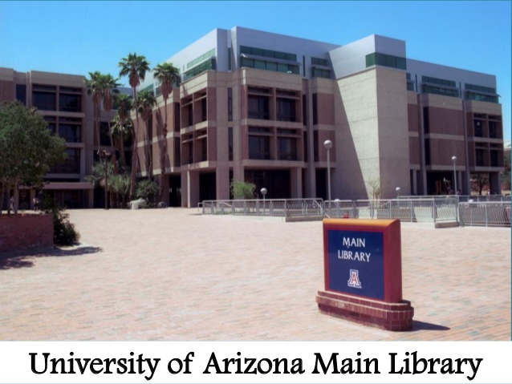
UofA Library Space Usage Assessment
MIS 587 Team 4
Abhinav Sharma | Renuka Unhale
Notes:
Add background pic of library

Slide 2
Client
University of Arizona Library
Department: Access and Information Services (AIS)
Key Contact:
John Miller-Wells
Assessment Manager – Access & Information Services
University of Arizona Library

Slide 3
Agenda
Overview
Current Situation
Business Problem
Data and Preprocessing
Client Requirements
Analysis Results

Slide 4
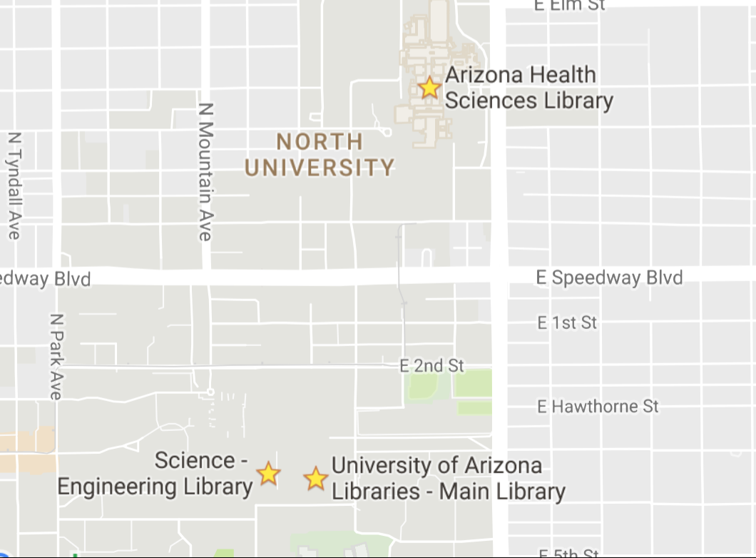
Overview
UofA has four libraries -
Fine Arts Library
Main Library
Science & Engineering Library
Health Sciences (Joined in 2016)
Library currently manages -
56 Group Study rooms
2 Practice Presentation / Skype
2 Mediaspace collaboration
14 Collaboration rooms

Slide 5
Overview
Earlier Policy –
Students can reserve for up to 2 hours
Bookings can be made up to 2 weeks in advance
2 active reservations on system at a time
Current Policy (After change in January 2016) -
Students can reserve for up to 4 hours
Bookings can be made up to 4 weeks in advance
4 active reservations on system at a time

Slide 6
Business Problem
Assessment of Occupancy and use of library space and facilities
Goals:
Assess how customers are using existing services
Develop recommendations for optimizing existing public spaces
Help the efforts related to possible renovations of library spaces
Notes:
Reporting tools built into the reservation software are limited o reporting on total reservations or total minutes reserved for a specified time period

Slide 7
Data Description
Source: Dibs reservation system
Dataset1: All UAZ reservations
Time Period: August 2012 to December 2016
Records: 362,093
Variables: ReservationID, RoomID, UserID, StartDate, EndDate, Status, ConfirmCode, DateEntered, LastUpdated, CancelledBy
Dataset2: Room Table
Variables: Room ID, Room Type, Maximum Occupancy, Floor, Library

Slide 8
Preprocessing
Converted all the dates in PST time zone
Removed all the admin user IDs
14 new variables and calculated fields created
Normalized room occupancy data
Notes:
Back to back, Time of day, Date entered PST, Duration, Days before booking, Maximum occupancy, Semester, Room rank, Status legends, user id, rank

Slide 9
Client Requirements
Possible patterns in use for specific rooms or locations within library
Possible patterns in reservation behavior
Do the same users book multiple reservations back to back?
How many bookings are same day vs. made in advance?
Changes in behavior after business rule changes in 2016
Notes:
dashboard1

Slide 10
Analysis Results
Preference of one area over another
Room Type – Group Study
Floor – First floor
Library – Main
Room Number – Main 104 C
2. Patterns in reservation behavior
Highest reservations during Fall semester, followed by Spring and least in Summer
More occupancy on Tuesday and least on Saturday
Evening is the favorite time slot to visit library

Slide 11
Analysis Results
3. Booking Patterns
People prefer to book the room on the same day
User Cancellation rate is proportional with the number of reservations
No particular pattern seen for the cancellations by Admin
4. Policy change impacts
Percentage of back to back bookings dropped from 7.83% to 2.92%
Number of reservations dropped, however the booking duration increased

